Slide 1


Mobile and Internet Programing
Group 17
CEF440
Instructor: Dr NKEMINI VALERY

Slide 2

Group 17
Overview of Mobile Application
Importance in Mordern systems
App typem Languages, Framework and Architecture
Introduction

Slide 3
Group 17
Types of Mobile App
Native Apps
Progressive Web Apps
Hybride Apps
Challenge: Fluctuations in raw material prices and economic conditions may impact profitability.
Challenge: Navigating complex regulations related to environmental standards and labor practices.
Challenge: Ensuring consistent cash flow to support operational needs and growth initiatives.

Slide 4
Group 17
Native Apps
Build for IOS ans Android
High Performance
Full device access
High Cost and Maintainance

Slide 5
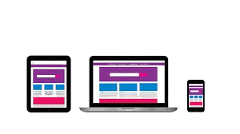
Group 17
Progressive web Apps
Runs in Browser
No Instalation Required
Cross-Platforms
Limite Device Access

Slide 6

Group 17
Hybrid Apps
Combines both Native and Web
Single code Database
Faster Development
Lower Perfomance

Slide 7

Group 17
Mobile application development involves multiple approaches and technologiesEach option (Native, PWA, Hybrid) has its own advantages and limitationsChoosing the right programming language and framework is crucialSoftware architectures (MVC, MVVM, VIPER) help structure applications efficientlyApplying the right design patterns and development process ensures quality
Swift for IOS
Kotlin for Android
Java
Dart
Objective-C
Python
And so more
Programming Languages

Slide 8
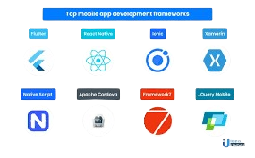
Group 17
Frameworks simplify mobile app development by providing tools and reusable components. Flutter, developed by Google, offers high performance and customizable UI. React Native uses JavaScript and is very popular. Xamarin, backed by Microsoft, uses C# and allows code sharing across platforms. Ionic focuses on hybrid apps using web technologies
Flutter
React native
Xamarin
ionic
Frameworks

Slide 9

Group 17
Architecture in mobile development is the structured design that defines how different components of an application interact to ensure scalability, maintainability, and efficiency.
Model View Controller (MVP)
Model Vikew ViewModel ( MVVM)
Viper
Architecture

Slide 10
Group 17
Mode View Controller (MVC)

Slide 11
Group 17
Mode View ViewModel (MVVM)

Slide 12
Group 17
Viper

Slide 13
Group 17
conclusion
Mobile application development involves multiple approaches and technologies
Each option (Native, PWA, Hybrid) has its own advantages and limitations
Choosing the right programming language and framework is crucial
Software architectures (MVC, MVVM, VIPER) help structure applications efficiently
Applying the right design patterns and development process ensures quality
Ultimately, success depends on balancing performance, cost, and user experience

Slide 14
Group 17
thank you
@reallygreatsite

